Slide 1


3-Phase Matrix Converter Chase Barnes
Daniel Loeza
Shanelle Algama

Slide 2
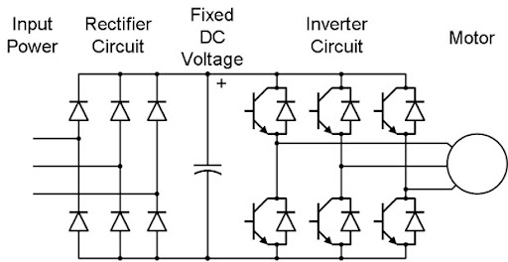
Project Description
Problem statement:
Conventional 3 Phase Motor Drivers, Variable Frequency Drives (VFDs) use AC-DC-AC Conversion
This results in decreased efficiency, along with high Harmonic Distortion that can cause problems for the connected equipment
Notes:
Chase

Slide 3
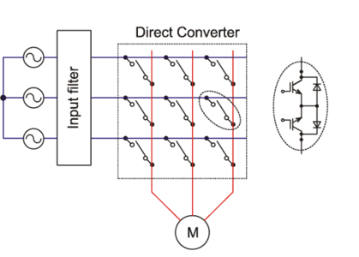
Project Description
Our Matrix Converter will provide AC-AC power, and will have higher efficiency at lower frequencies than VFDs traditionally do, along with lower harmonic distortion.
Notes:
Chase

Slide 4
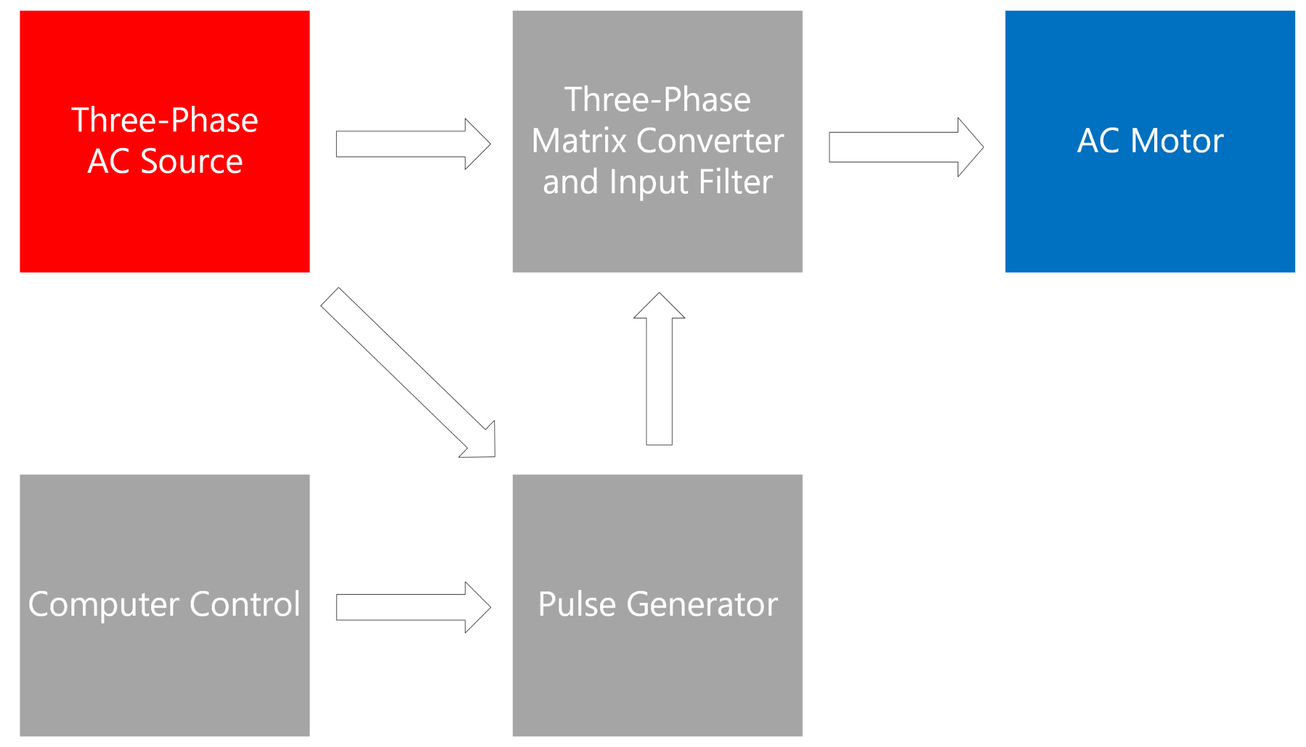
Project Description
This converter will have three subsystems, which are the matrix of bidirectional switches with input filter and varistors on the input and output three-phase, the pulse generator circuit to control the switches, and the firmware, which will control the frequency of the output. The input will be 208V 60Hz three-phase power and the output will be 208V variable 0-60Hz three-phase power.
Notes:
Shanelle

Slide 5
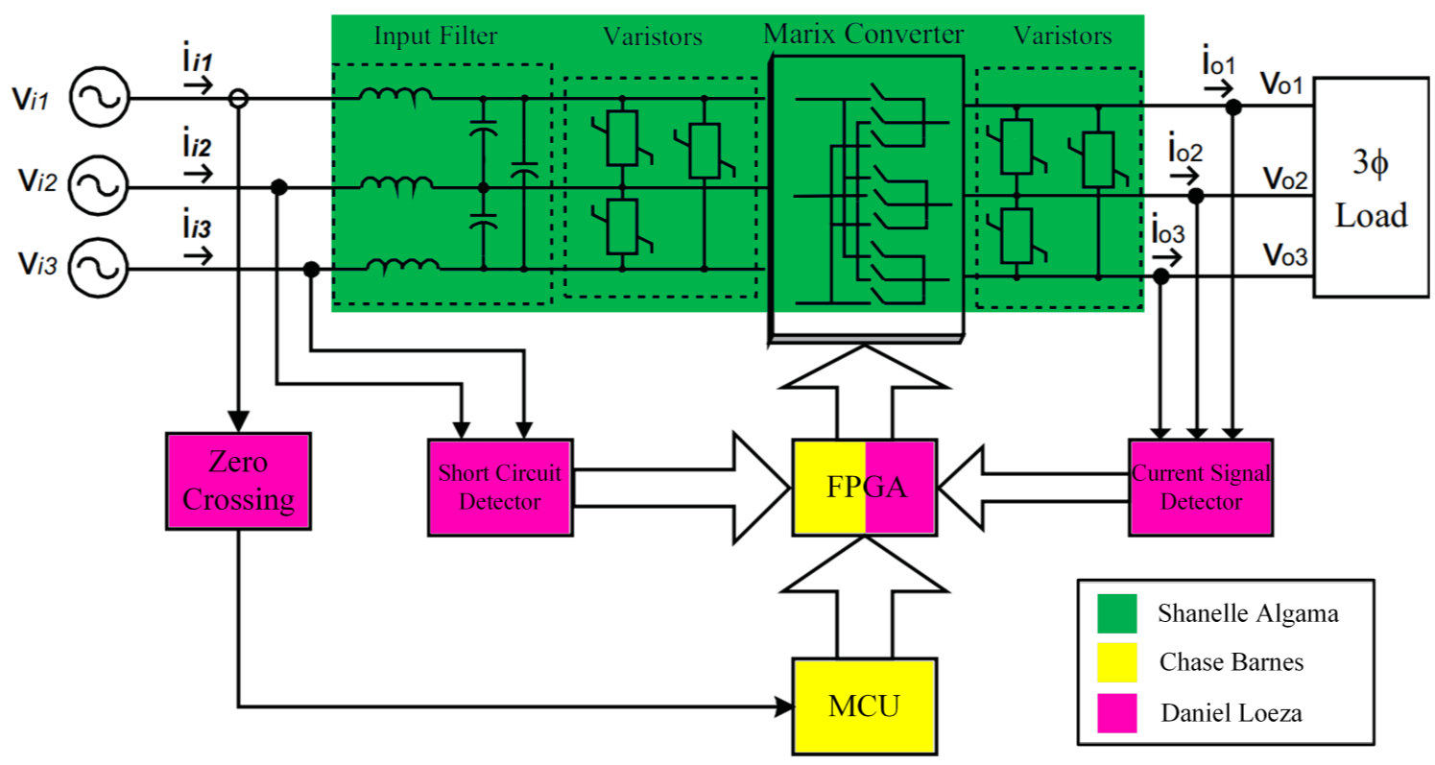
System Overview
Notes:
Shanelle

Slide 6
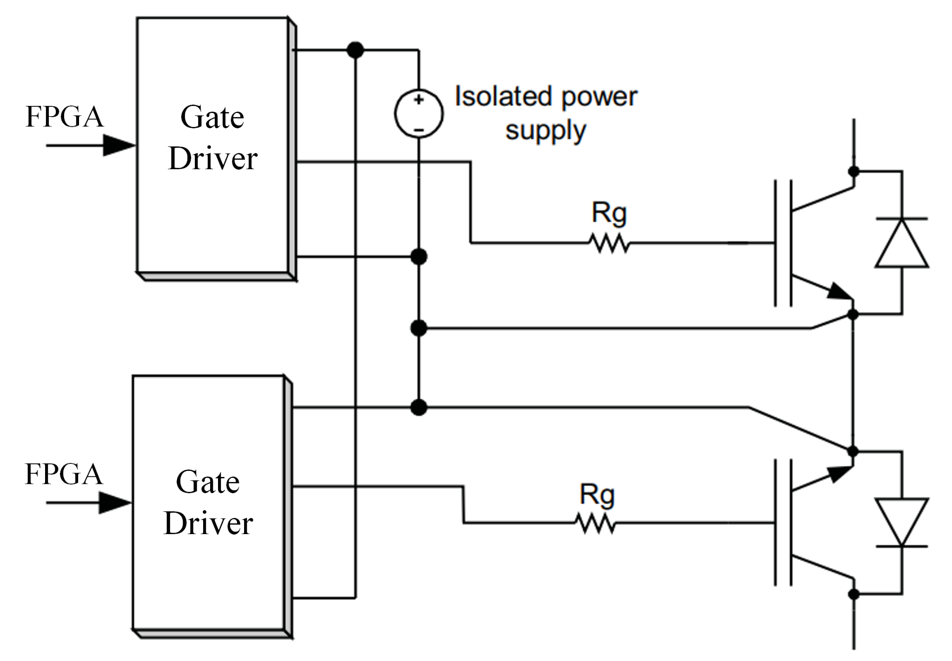
Matrix Converter Circuit Board
This is the power electronics system designed to perform direct AC-AC conversion without an intermediate DC link.
The source three-phase AC power will be directly connected to the input stage of the converter, which includes varistors for overvoltage protection and an input filter. (LC)
Utilizes a 3x3 matrix of bidirectional semiconductor switches which comprises of two IGBT transistors and two gate drivers.
This will total to 18 IGBT transistors and 18 gate drivers
Will include three more varistors on the output phases
Bidirectional Switch with Common Emitter Configuration
Notes:
Shanelle

Slide 7
Pulse Generator Circuit Board
The Pulse Generator Circuit Board will house 3 sensors. These sensors will be Zero Crossing Sensors, Current Signal Detectors, and Short Circuit Detectors.
The Zero Crossing Sensor will detect when the all 3 phases change their signs.
The Current Signal Sensor will detect when either current is flowing into the load or out of the load.
The Short Circuit Sensor will detect for any short circuits within the Matrix Converter.
All outputs of these sensors will feed into the MCU/FPGA to trigger appropriate stages.
Notes:
Daniel

Slide 8
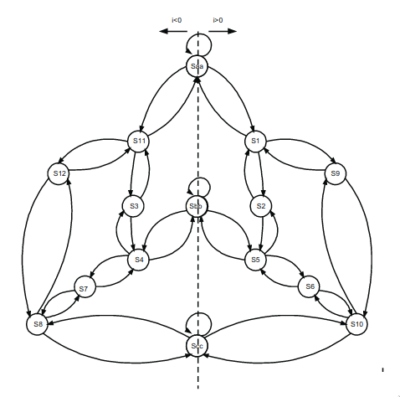
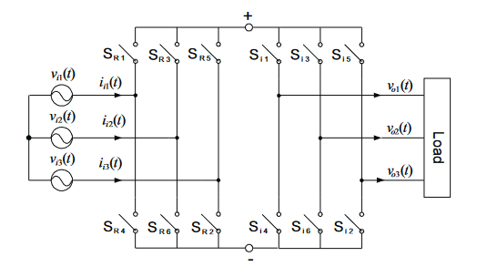
Microcontroller and FPGA Firmware
FPGA Firmware:
Safe Commutation System Allows Bidirectional Switches to not short
Microcontroller Firmware:
Modeling the design virtually as a 2 stage rectifier and inverter stage allows for utilization of the Space Vector Modulation Algorithm. This is able to provide the correct load output for each phase to then be fed into the FPGA
Notes:
Chase

Slide 9
Matrix Converter Circuit Board Progress
Part Type | Part Name | Info | Price | Cons
IGBT | STGW19NC60HD | 600V 19A 97ns Td off | $3.11 Per $55.98 18x | Price
 | STGP19NC60HD | 600V 19A 97ns Td off | $2.72 Per $48.96 18x | Price
 | IKP10N60TXKSA1 | 600V 10A 215ns Td off 5 μs Short Protection | $1.73 Per $31.14 18x | Price Slow Td off
 | STGF10M65DF2 | 650V 10A 96ns Td off 6 μs Short Protection | $1.25 Per $22.50 18x | Plastic Packaging
Gate Drivers | HCPL-3150-000E | 0.6 A max output 0.5 A min output | $3.26 per $58.68 18x | Price
 | HCPL-315J-500E | 0.6 A max output 0.5 A min output 2 Gate Drivers Less Components | $6.87 per $49.84 10x | Price
 | HCPL-0302-000E | 0.4 A max output 0.2 A min output | $2.24 per $26.93 18x | Lower Amperage Output
Varistor | B72220S0151K101 | 240V 8kA
 | B72214Q0151K101 | 240V 8kA

Slide 10
Pulse Generator Circuit Board Process
Part Type | Part Name | Info | Price | Cons
Microcontroller | STM32G491CET6 | 512KB Flash 48-LQFP 170MHz | $8.51 per | Price
 | STM32G491KEU6 | 512KB Flash 32-UFQFPN 170MHz | $7.93 per | Smaller Package size
 | STM32H733VGT6 | 1M Flash 100-LQFP 550MHz | $12.61 per | Price
 | STM32H745ZIT6 | 2M Flash 144-LQFP Dual Core 240MHz, 480MHz | $18.85 per | Price
MCU Dev Board | NUCLEO-G431RB | STM32G4, more IO 48MHz Clock | $15.96 per | Limited Clock to original Component
 | NUCLEO-G431KB | STM32G4, less IO 24MHz Clock | $12.77 per | Limited IO and Clock
 | NUCLEO-H7A3ZI-Q | STM32H7 | $29 per | Limited Clock
CPLD | LC4032V-25TN44C | 2.5ns delay time 32 Macroblocks 60mA output current 44-TQFP | $7.25 per $21.75 3x | Expensive Dev Board limited macroblock size
 | LC4256ZE-B-EVN | ispMACH 4000ZE | $142.8 per | Price
 | LC4256V-B-EVN | ispMACH 4000V | $199 per | Price

Slide 11
Pulse Generator Circuit Board Cont.
Part Type | Part Name | Info | Price | Cons
FPGA | LCMXO3D-9400HC-6SG72I | Onboard Flash 442368 RAM Bits 10mA output current | $34.85 per | Less Expensive that CPLDs No Additional Flash Requirements
 | LCMXO3D-9400HC-5SG72C | Onboard Flash 442368 RAM Bits 10mA output current Worse Operating Temp | $28.70 per | Less Expensive that CPLDs No Additional Flash Requirements Cheaper than Other
FPGA Dev Board | LCMXO3D-9400HC-B-EVN | MACHXO3D | $94.8 per | Less Expensive than CPLD Devs
Zero Crossing | BM1Z003FJ-E2 | 0 μs delay | $2.39 Per $14.34 6x | Price
Hall Effect | ACS730KLCTR-20AB-T | 4.7V to 0.1 Range 1MHz Output +-20A | $4.27 per $32.04 10x | Price

Slide 12
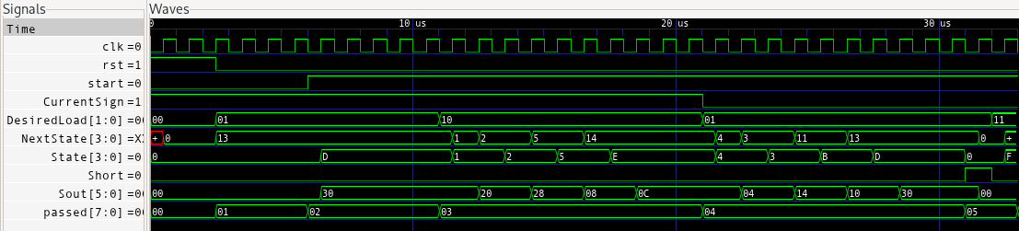
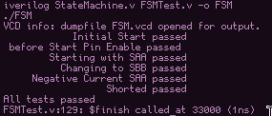
FPGA And MCU Firmware Progress
Notes:
Chase

Slide 13
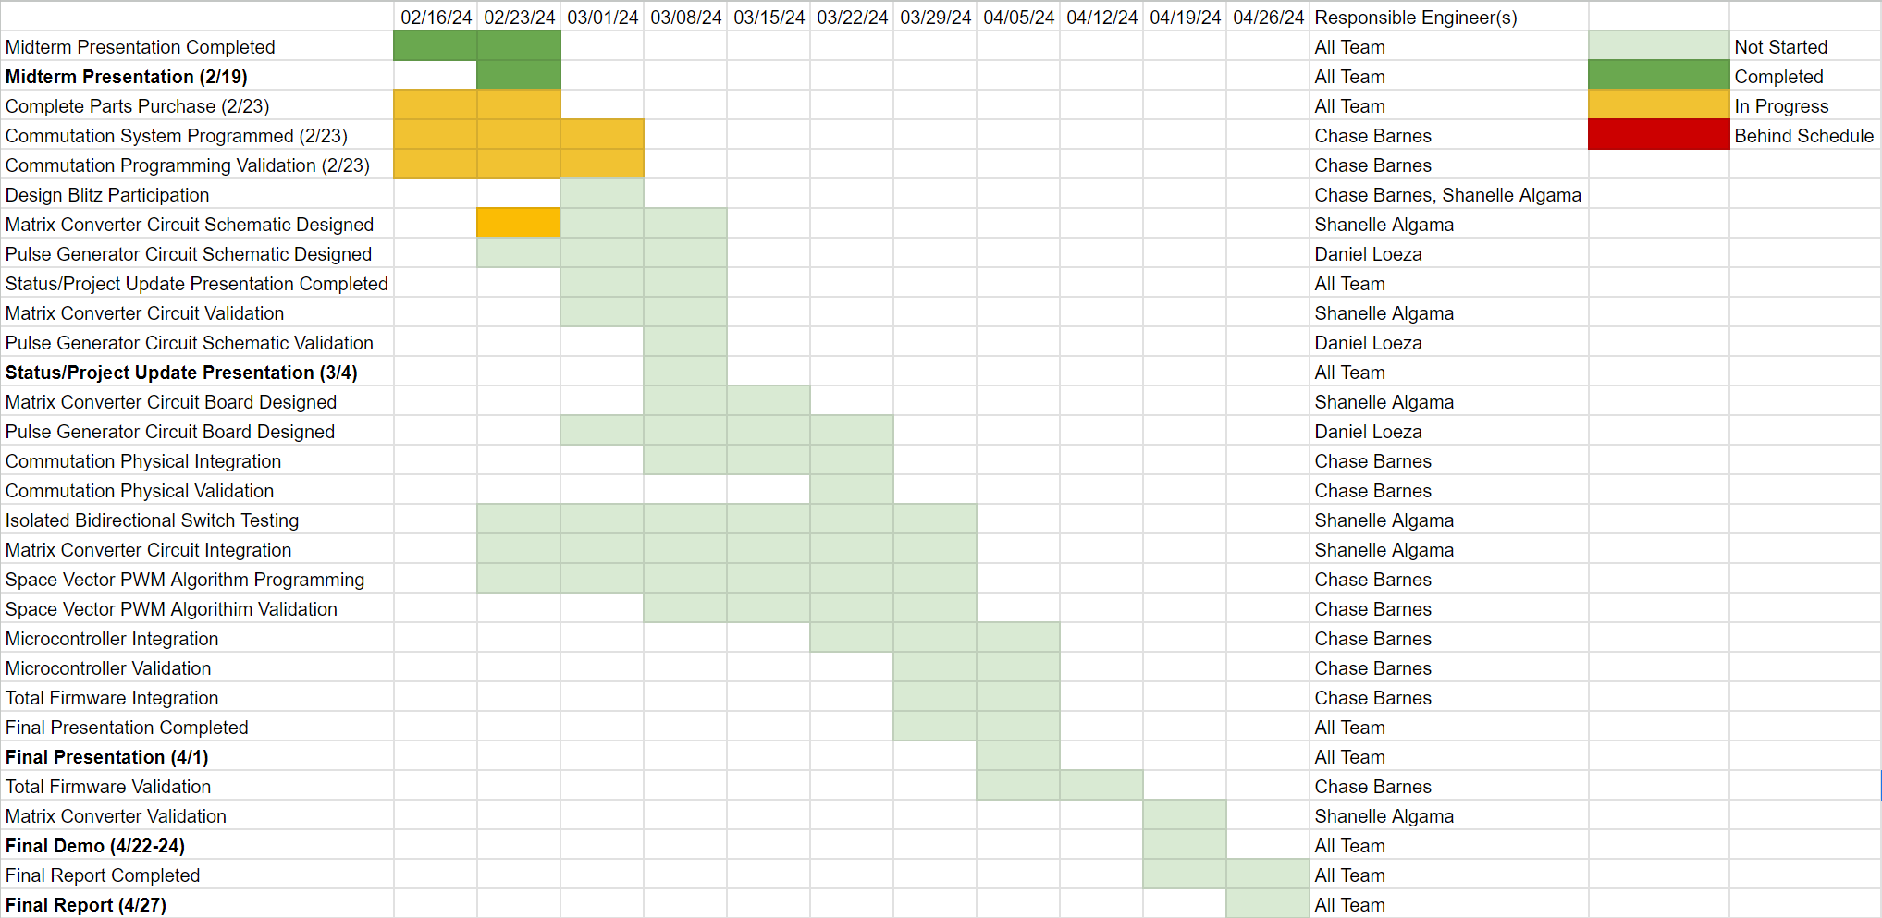
Execution Plan
Notes:
Daniel

Slide 14
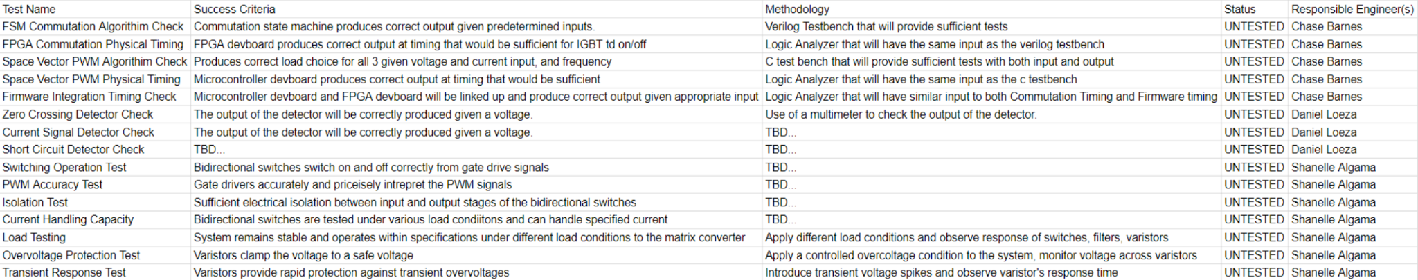
Validation Plan
Notes:
Daniel

